Slide 1
Pushing beyond
maintaining a good balance of challenge and support in an introductory database class

Slide 2


As Envisioned by Harry Potter

Slide 3

Database Class
Where did we come from
Change
Disruption
Rebalancing

Slide 4

Where Did We Come From
Many years of very polished database sequence – 3 classes
Polarizing professor
Notes:
Foundations of Information management – Access/Visio
Enterprise Information Management
Data Warehousing and Business Intelligence ----Servius Snape

Slide 5
Where Did We Come From
Upper Division Intro class for majors and minors
DB Design, Normalization, Build DB, Write Queries, Make Reports, Make Forms (Access)
Flat Out Run for 10 Weeks

Slide 6
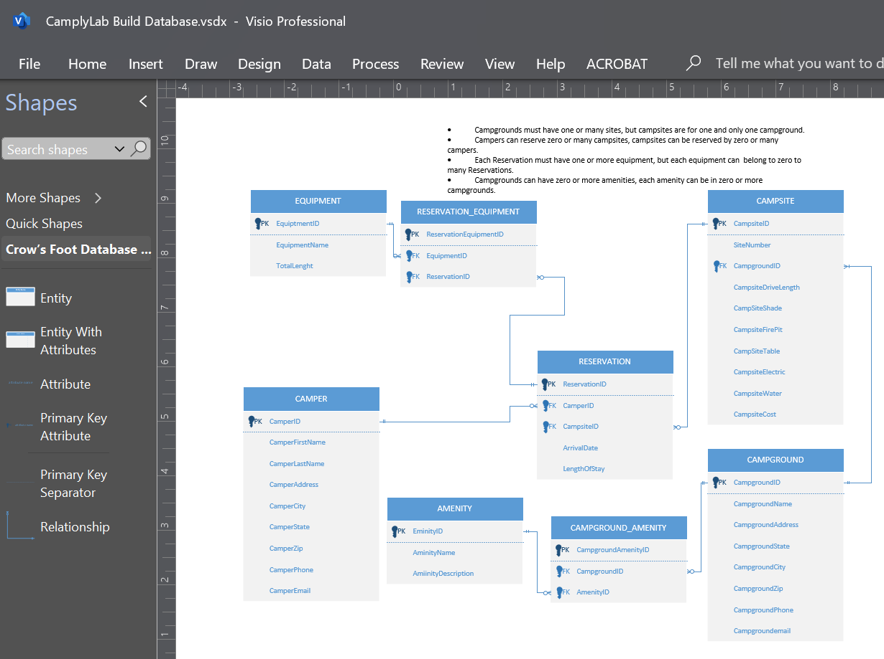

Slide 7
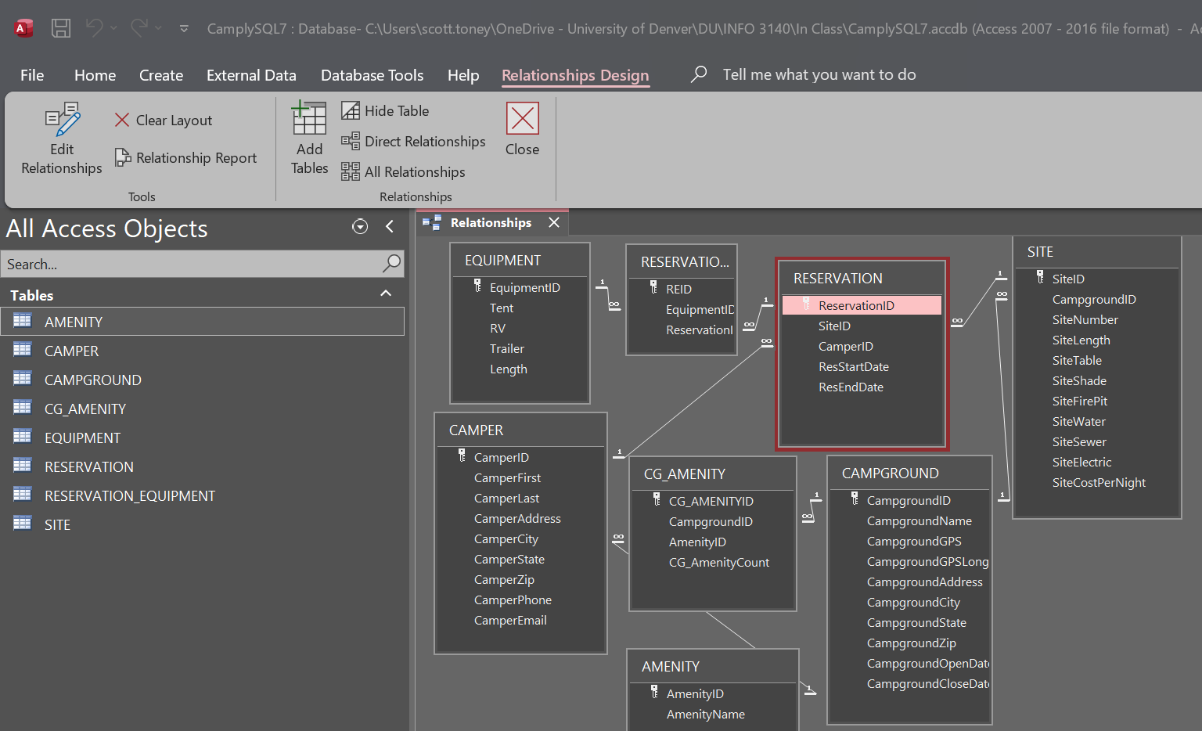

Slide 8
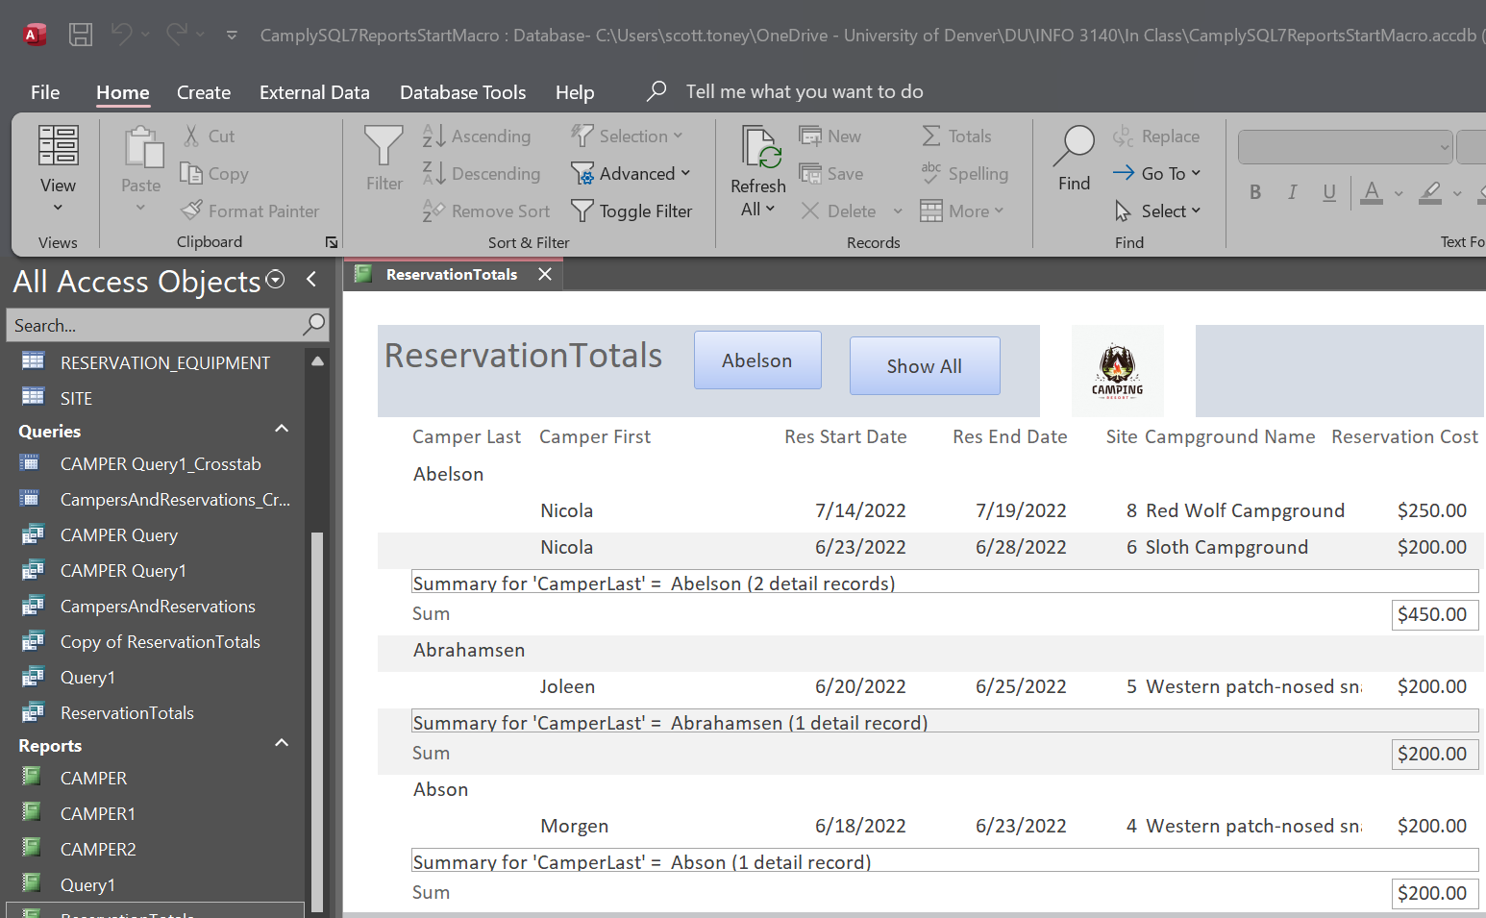

Slide 9
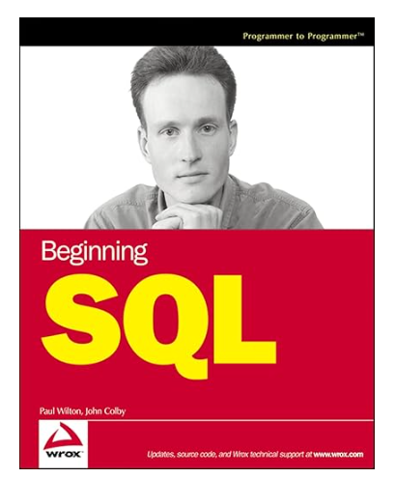
Where Did We Come From
2 books
In Class Lectures
Daily in class work
Quarter Long Project
TA
Notes:
From 2005

Slide 10

Change
Retirement
New Instructors Top To Bottom
Change of Philosophy – Kinder and Gentler
Notes:
Albus Dumbeldor

Slide 11
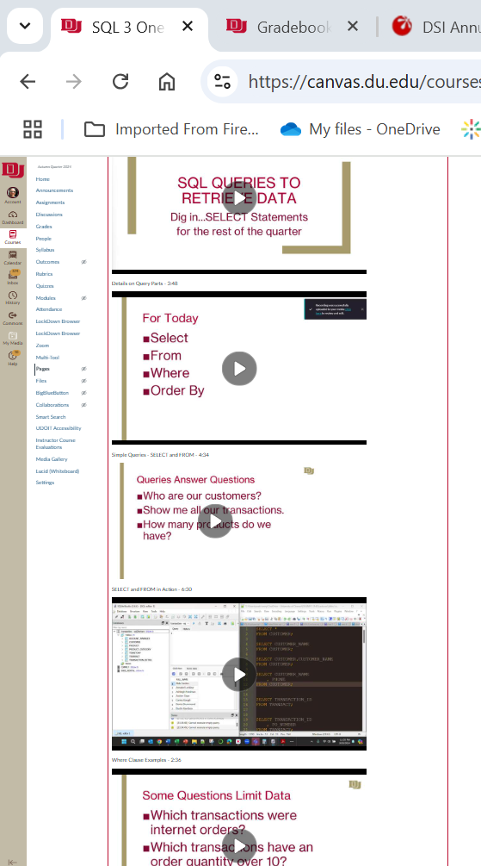
Change
Removed forms
More practice on queries
Flipped Classroom
Books optional
Kept Quarter long project

Slide 12
Change
More time in class to practice, ask questions
Continued to work in teams and get feedback from class
Found software to help students with Macs

Slide 13

Disruption
Loved by top students
Weaker students struggled mightily
More “figure it out” from the POV of students
Notes:
Gilderoy Lockhart

Slide 14
Disruption
New Professor With New Style
Same class, same LO’s, more challenge, less guidance
Integrate AI with Access as part of final project/contest

Slide 15
Disruption
Not clear that LO’s were priority
Not clear that students were ready for second class
But….AI integration meets an industry need

Slide 16

Rebalancing
Update Software (SQLite, Lucid Charts)
Move from reports and forms to visualizations (Tableau)
Possible move to MySQL
Notes:
Remus Lupin

Slide 17
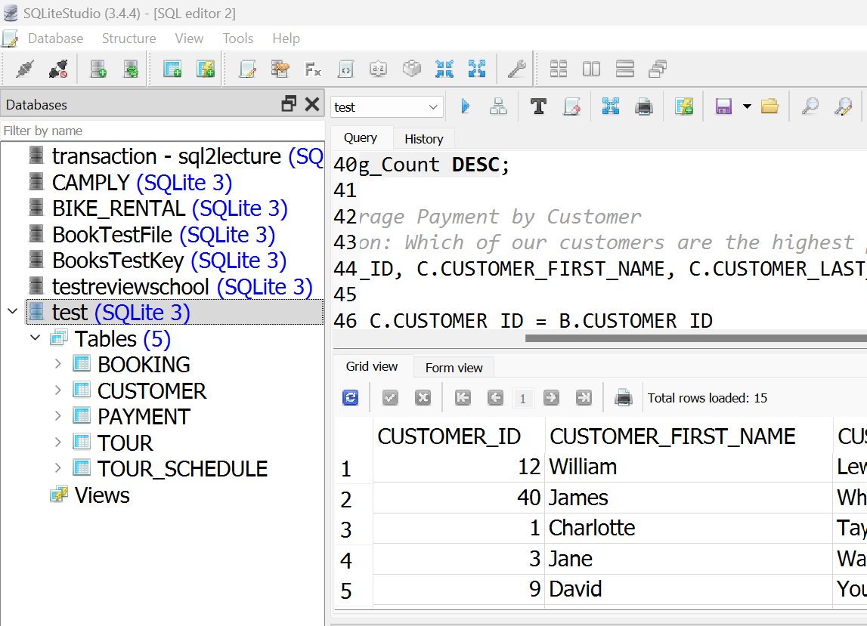

Slide 18
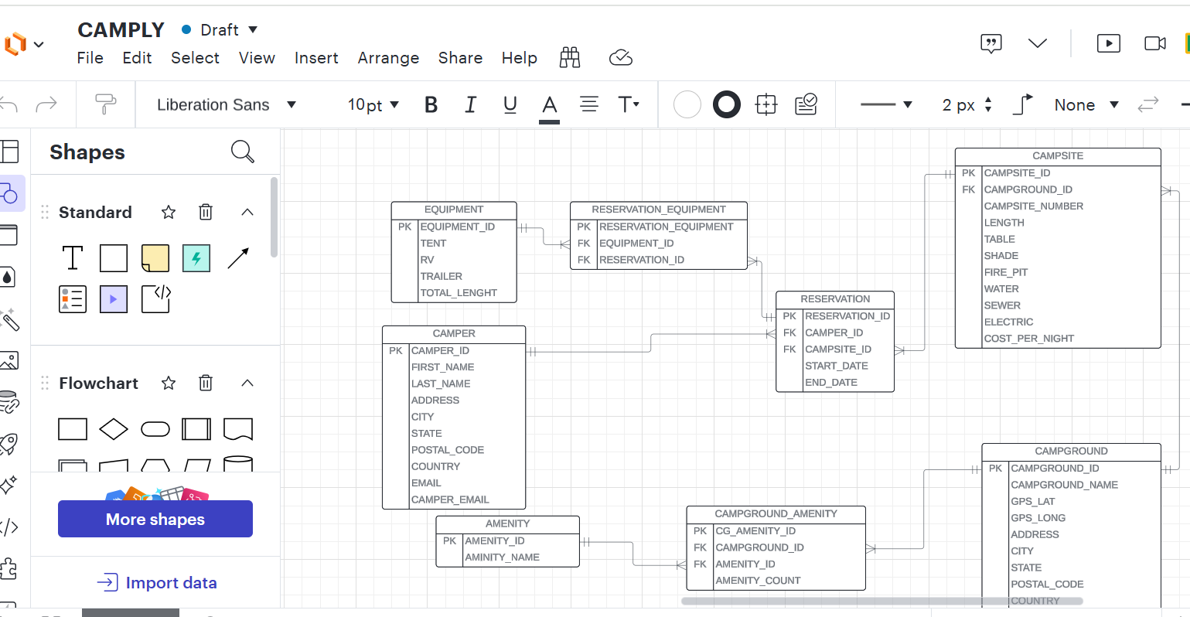

Slide 19
Rebalancing
Did not get to AI integration
Did find time for 9 query exercises with more than 300 queries to work through
AI cool use: Insert Statements

Slide 20
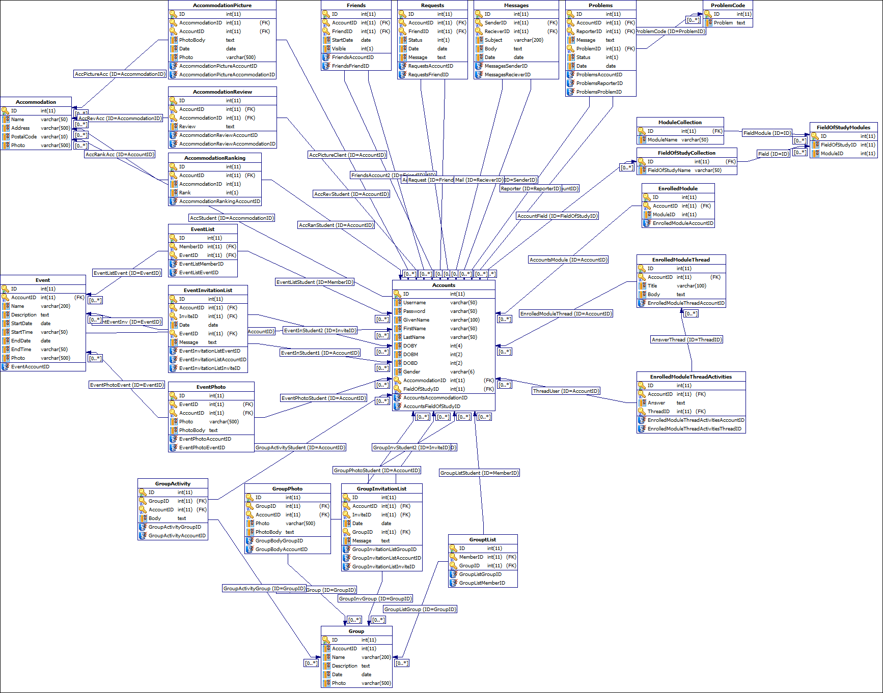
Rebalancing
What should the Intro to Database class look like?
What about 2 follow on classes? (1 year sequence)

Slide 21

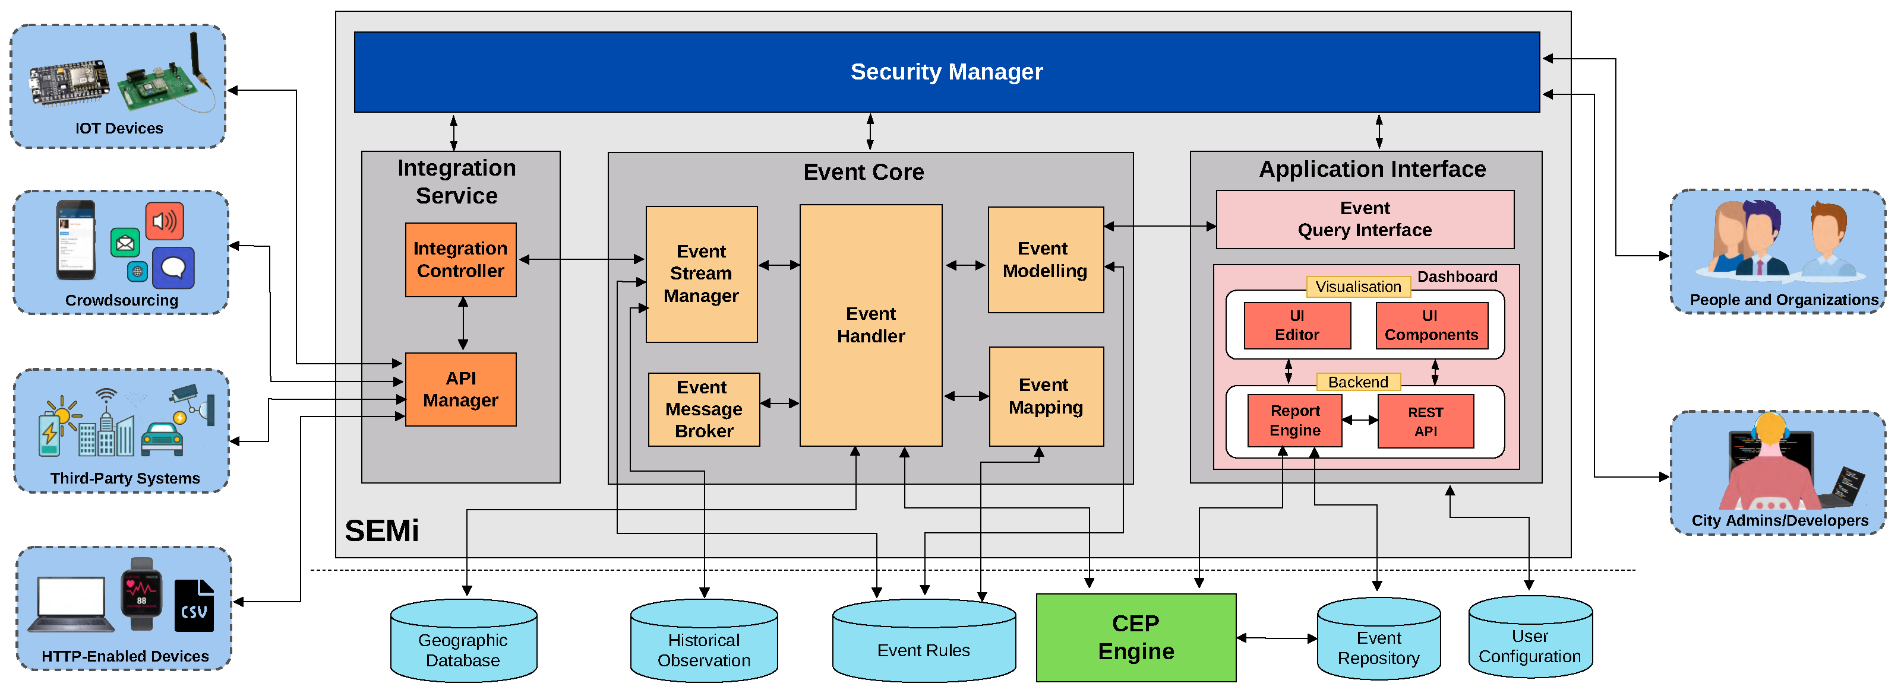
Rebalancing
What Software?
Cloud?
AI?
Creation of DB driven applications?

Slide 22

Rebalancing
We teach Business Analytics…
Who should our students become?
Notes:
Harry Potter

